Slide 1

5G Network Slicing Simulation

Slide 2
Why 5G?
5G wireless networks are envisioned to meet the rising demand for network services from users. User devices have evolved and demand different services from the network. The user demands can be categorized based on latency, reliability and bandwidth required.
Resource Efficiency: 5G enables the efficient use of physical infrastructure by allowing multiple virtual networks to operate simultaneously, optimizing resource allocation and reducing costs.
Enhanced Quality of Service (QoS): With 5G's capabilities, network slicing can guarantee specific QoS parameters, such as low latency and high reliability, which are crucial for applications like remote surgery and autonomous vehicles.
Scalability: 5G network slicing supports the scalability of services, enabling operators to quickly adapt to changing demands and deploy new applications without significant infrastructure changes.
Multi-Tenancy Support: It allows multiple service providers to share the same physical network infrastructure while maintaining isolation and security between different network slices, promoting competition and innovation in the market.

Slide 3
What slicing simulation aims to do?
5G widely defines network slicing concept which provides different and separate dedicated logical networks that can be customised to respective services.
Model Conversion: It transforms complex 3D models into a series of manageable layers, allowing for easier processing and printing in 3D printing applications.
Optimization: The simulation optimizes the printing process by determining the best layer thickness and print paths, which can enhance print quality and reduce material waste.
Performance Analysis: It evaluates the performance of different slicing strategies, helping to identify the most efficient methods for specific types of models and materials.
Network Management: In the context of network slicing, it simulates the creation of multiple virtual networks on a shared infrastructure, allowing for better resource allocation and management of network services.

Slide 4
Mobility Management
With the introduction of diverse 5G application scenarios, new mobility management schemes must be implemented in Sliced 5G networks in order to guarantee seamless handover between network slices. Mobility management allows users to move from one coverage area to another without losing network connection.
Seamless Handover: Mobility management ensures seamless handovers between different network slices, minimizing service interruptions as users move.
Context-Aware Decisions: It utilizes user context information (e.g., speed, location) to make informed decisions about slice selection and resource allocation, enhancing the user experience.
Quality of Service (QoS) Preservation: The system maintains the required QoS levels during user mobility, ensuring consistent performance for applications and services.
Dynamic Load Balancing: Mobility management facilitates dynamic load balancing across network slices, optimizing resource utilization and preventing congestion in high-traffic areas.

Slide 5
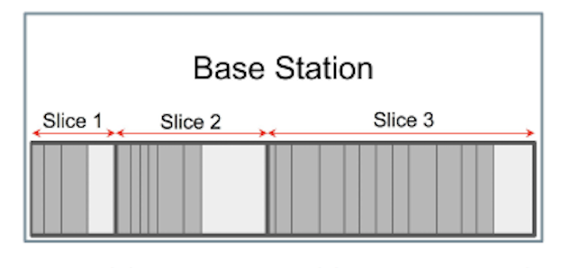
Structure:
A base station has slices in it tailored for different needs:
Guaranteed bandwidth for each customer
Max bandwidth limit for each customer
Allocated throughput for a slice
QoS class
Delay tolerance

Slide 6
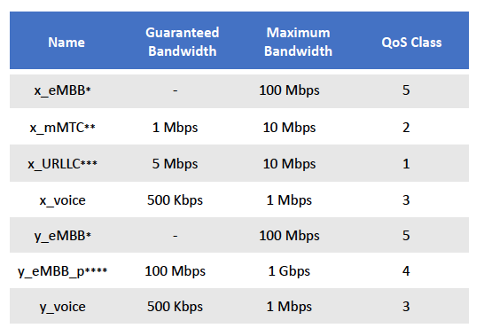
Slices:
eMBB (Enhanced Mobile Broadband): High-speed internet for applications like VR/AR.
mMTC (Massive Machine-Type Communications): Supports IoT with low power and high device density.
URLLC (Ultra-Reliable Low Latency Communications): For mission-critical applications like remote surgery.

Slide 7
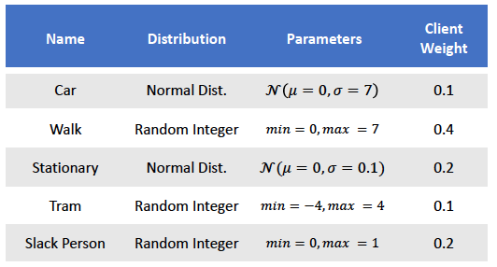
Mobility Patterns

Slide 8
Conclusion
Increasing number of clients increases used bandwidth, and yet the simulation showed that block ratio also elevates for this specific configurations.
This simulation tool can be used for such scenarios as well:
Testing the effect of different dynamic slicing algorithms on block and handover ratios.
Analyzing various mobility patterns of clients using different statistical distributions.
Observing the effect of usage frequency of clients and the effect those are distributed unequally.
Various Proof of Concepts like common base stations for multiple service providers.

Slide 9
Thank You

